Slide 1
PROJECT
EXPLORATORY DATA ANALYSIS

Slide 2


1. MAXIMUM total laid off AND MAXIMUM percentage laid off

Slide 3

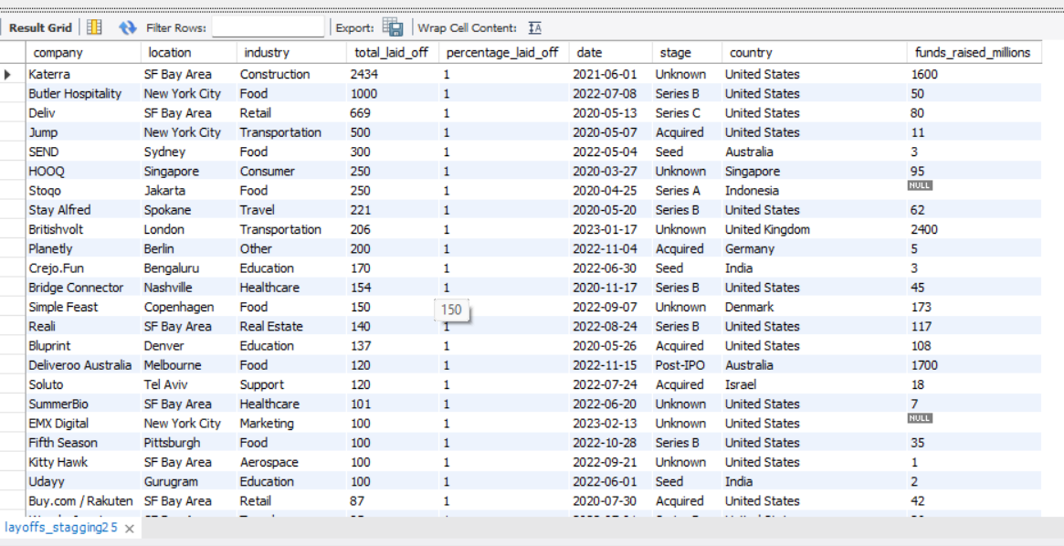
2. Companies with 100% layoffs

Slide 4

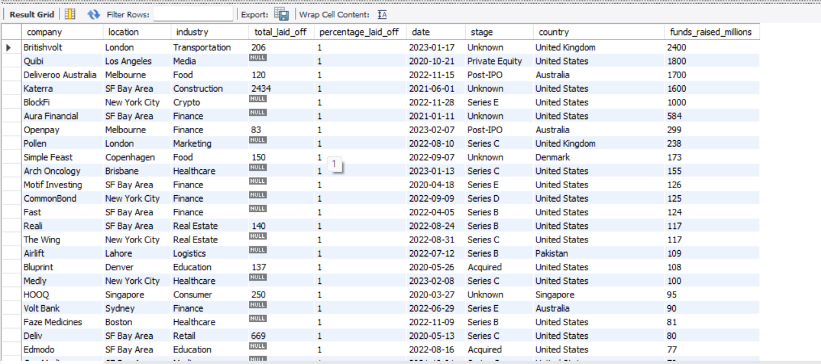
3. Companies with 100% layoffs despite having maximum funds

Slide 5

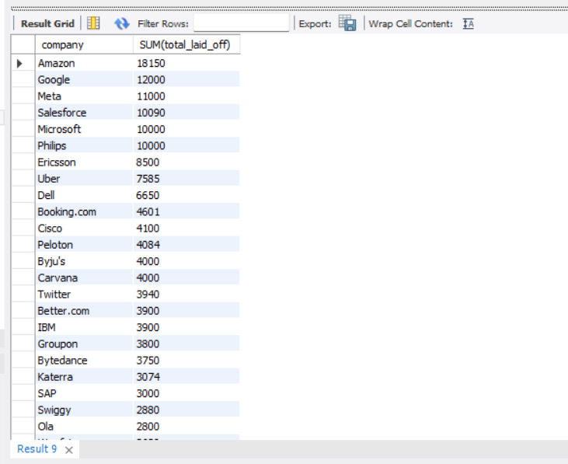
4.Total layoffs over each company

Slide 6


5. Layoff period

Slide 7

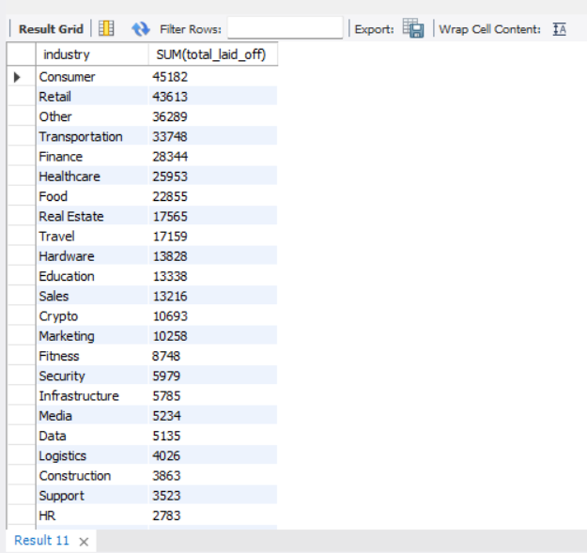
6. Total layoffs over each industry

Slide 8

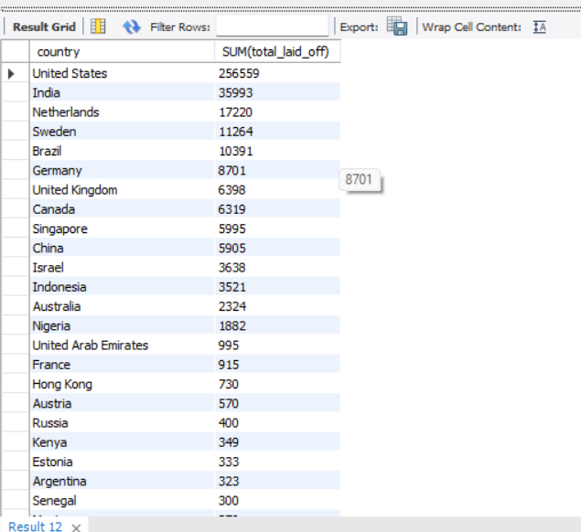
7.Total layoffs over each country

Slide 9


8. Total layoffs over year

Slide 10

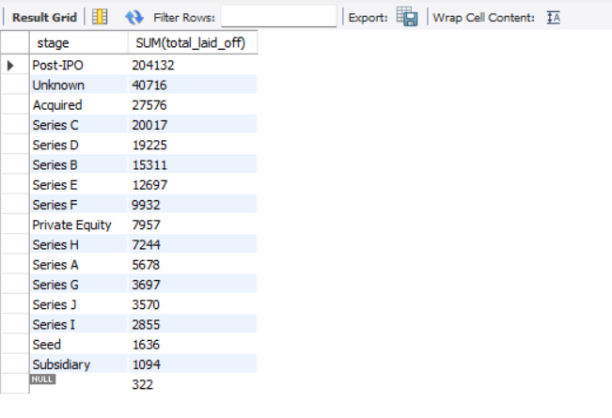
9. Total layoffs over stage

Slide 11

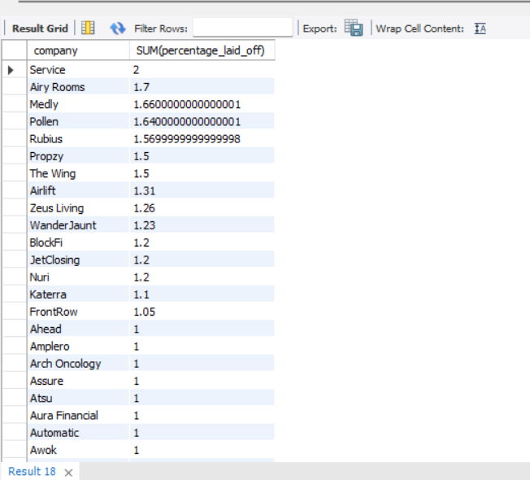
10. Total percentage laid off over each company

Slide 12
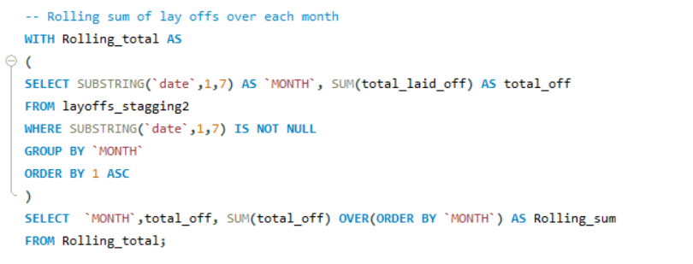
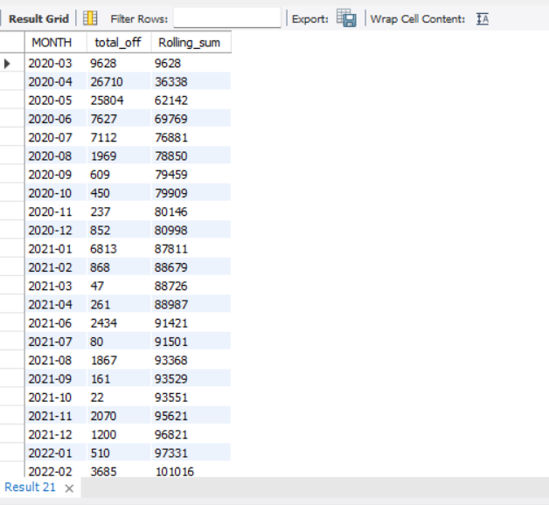
11. Rolling sum of lay offs over each month

Slide 13

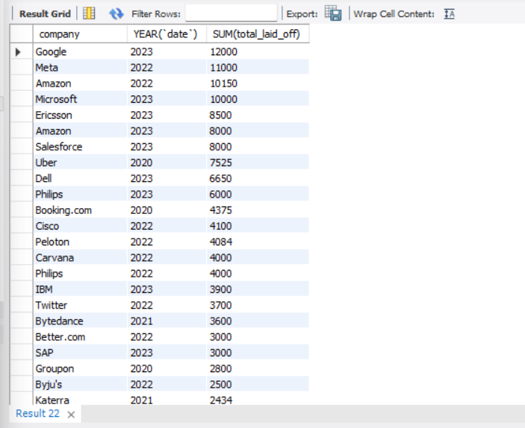
12. Total laid offs per company over each year

Slide 14
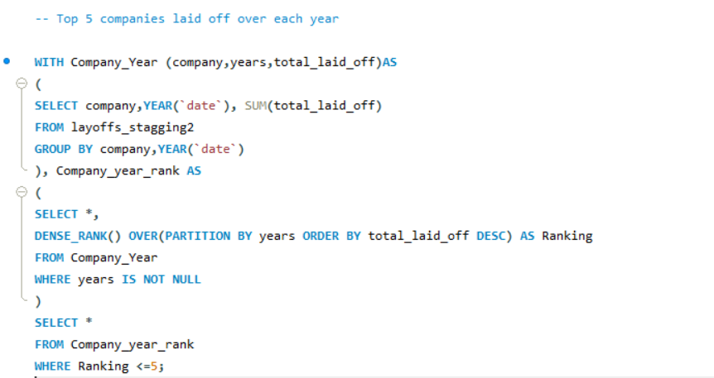
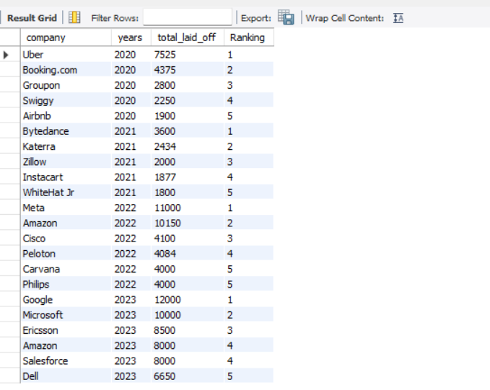
13. Top 5 companies laid off over each year

